Slide 1
Computer Application
Chapter 1
Computer Terminology & Organization
Computer Peripherals

Slide 2
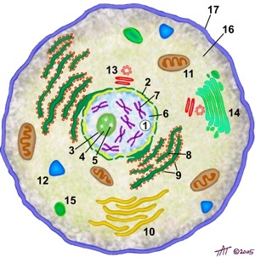

BIT vs Cells and Atoms
Just like humans are made up of tiny cells and objects are made up of atoms.
All data in a computer are made of BITS.
Bits

Slide 3
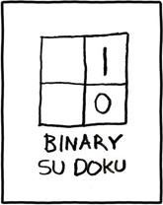
What is a bit?
A bit is the smallest data form that has only 2 values (binary).
It is either a 1 or 0 and can be lined up in a sequence to represent other data. Example: 101011101000110
There are 10 kinds of people in the world:
Those who understand binary, and those who don’t.

Slide 4
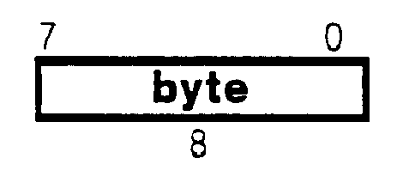
Byte
Bytes are the standards measurement units for size in computers.
8 bits form up a Byte.
1 Byte= 8 bits

Slide 5
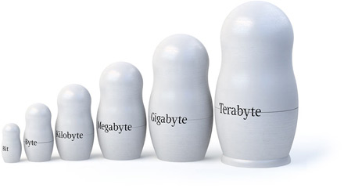
The Measurements of sizes…
1 Byte = 8 bits
1 KiloByte = ~1,000 Bytes
1 MegaByte = ~1,000,000 Bytes (Million)
1 GigaByte = ~1,000,000,000 Bytes (Billion)
1 TeraByte = ~1,000,000,000,000 Bytes(Trillion)

Slide 6
The PC’s Anatomy

Slide 7
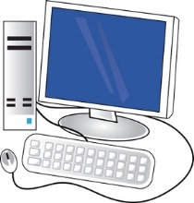
PC Anatomy
The CPU
The Cache
The RAM
Storage devices
Video Card
Graphic Card
Motherboard

Slide 8
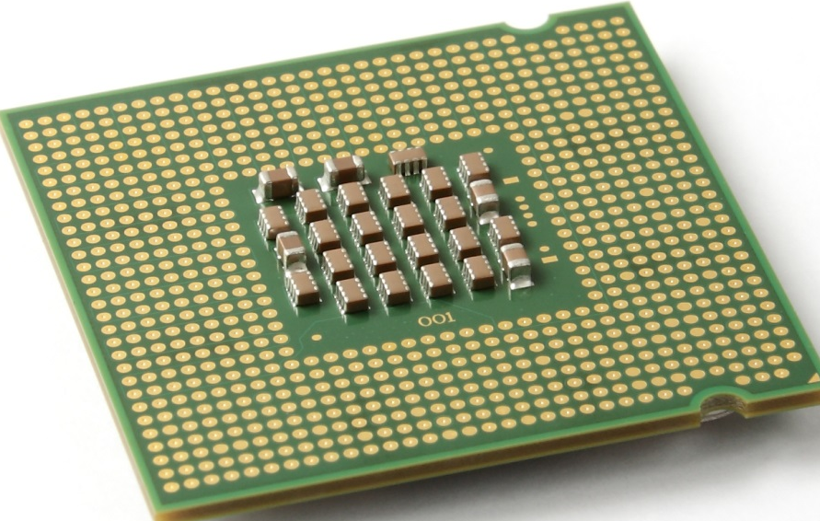
CPU
The CPU is the abbreviation for Central Processing Unit.
It handles every piece of data being processed by the PC.
It is the “Brain” of the PC.

Slide 9
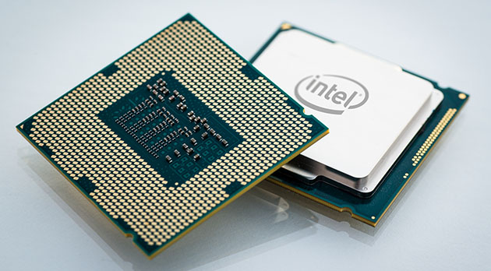
CPU
There are 2 known manufacturers for CPUs:
Intel (Pentium, Centrino, QuadCore, Core i7, etc…)
AMD(Athlon, Turion, Phenom, etc…)
CPU Speed is measured in Hz and all current PCs have speeds in GHz (GigaHertz).
Manufacturers are not working on faster CPU speeds, but more “Cores”.

Slide 10
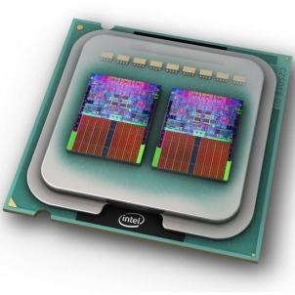
Multicore CPU
Each Core in the CPU can process calculations on its own.
This can help in reducing time for calculations in case multiple applications are being used.
A Multicore CPU with a speed of 1.5GHz, means that each core has that speed. (They do NOT add up to 3GHz in case of 2 cores, nor to 6Ghz in case of 4 cores)

Slide 11
The Cache
A defining factor other than the speed and number of cores is the cache.
The cache is a buffer zone which keeps the data to be calculated by the CPU.
The larger the cache, the more data the CPU will be able to handle at a time.
Current sizes of cache are in MBs (MegaBytes).
When a processor need to read or write it checks for data in the cache first.

Slide 12

The RAM (Random Access Memory)
The Memory of the PC is known as the RAM.
It holds all the resources and data needed by the application you are currently using.
Once the application is closed, it will be removed from RAM.
RAM is volatile

Slide 13
The RAM in some detail…
RAM is made of pure electricity; i.e. when the electricity is cut off the whole system, the data in the RAM is lost.
The RAM is measured size in Bytes (MBs, GBs), and speed in Hz.

Slide 14
Storage Devices
There are currently 2 types of storage devices used:
The Hard Disk Drive (HDD)
The Solid State Drive (SSD)
There are also removable Storage devices such as:
CDs, DVDs
Flash USB Drives
External Hard Disks
Storage Devices have a Write/Erase Lifetime.

Slide 15
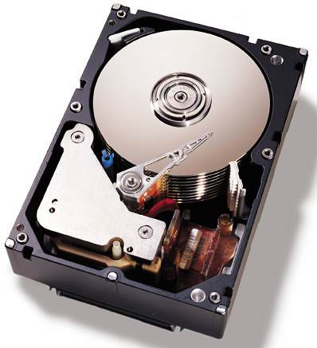
Hard Disk Drives
Hard Disk Drives are permanent storage devices used for keeping all files you need.
They are defined by their:
Size: in Bytes (usually GBs and TBs)
Speed: in rpm (standards: 4200, 5400, 7200, 10000)
Buffer: in MBs (higher buffer = better feed)

Slide 16
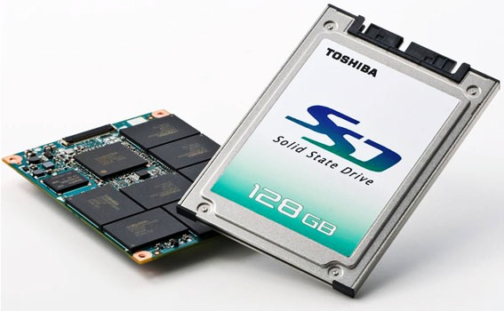
Solid State Drives
Solid State Drives are the latest technology in Storage Devices.
They work on the same basis as Flash Disk Drives do. Meaning that the data is stored on chips instead of disks.
Solid State Drives are known to have way better (reading) speeds since they work on electricity as RAMs do.

Slide 17
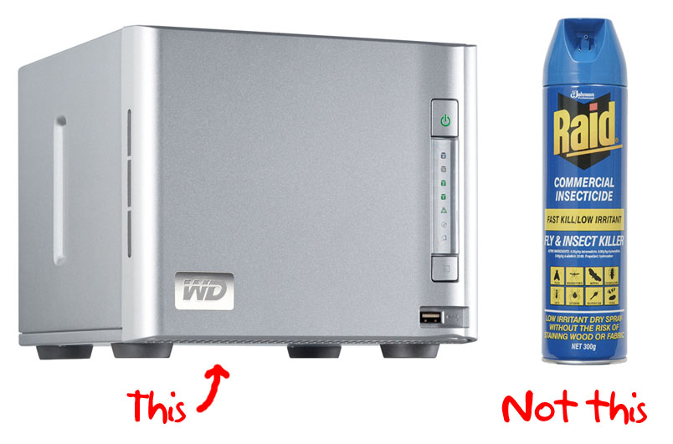
What is RAID?

Slide 18
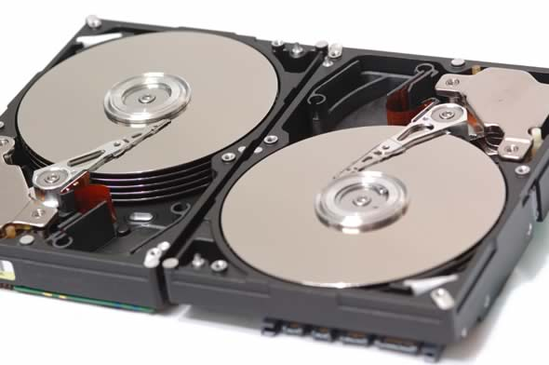
Storage Drives (RAID)
RAID technology uses 2 or more Hard Disk Drives to help in backing up your data or in helping make the read/write process of data faster.
Examples of RAID Types:
RAID 0: distributes data across several disks in a way that gives improved speed and full capacity, but all data on all disks will be lost if any one disk fails.
RAID 1: Two (or more) disks each store exactly the same data, at the same time, and at all times.

Slide 19
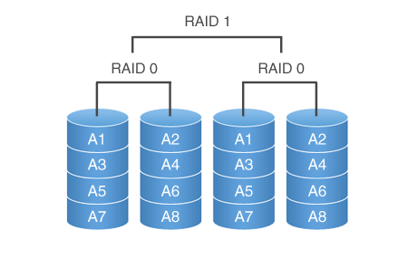
RAID Example

Slide 20
How a Software Loads…
CPU
Buffer
RAM
Storage Device
(HDD or SSD)

Slide 21

Video Card
The Video Card or Graphics Accelerator Card is used to generate and output images to a display.
It is an independent component that computes the data related to the images and videos seen on a Screen.
It has its own set of RAMs to be used as memory.
It uses a GPU (Graphics Processing Unit) to compute the data in the best manner for images and videos and games.

Slide 22
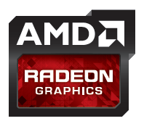
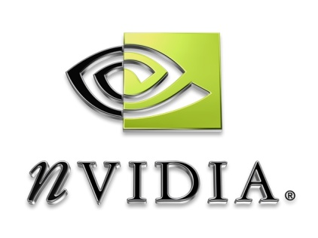

Graphic Cards Companies
There are 3 Manufacturers for GPUs and Graphics Cards in general:
Intel
nVidia (GeForce series)
AMD (Formerly known as ATI)
Intel are known to not have powerful graphics while the other two are dedicated companies to Graphic Cards.

Slide 23
The Motherboard
The Motherboard is the Spinal Cord of the PC.
ALL the components of a PC are connected to the Motherboard.
It has slots for the CPU, RAM, Video Card, Hard Disk, CD/DVD ROMs, etc…

Slide 24
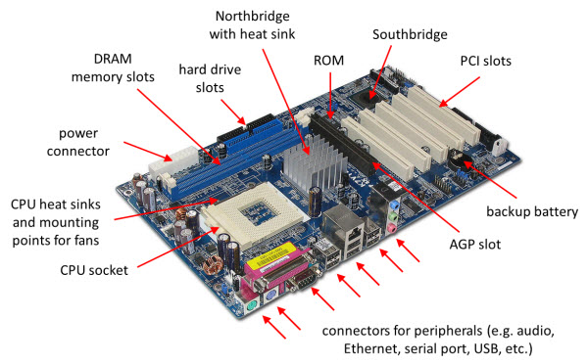

Slide 25
Computer Peripherals

Slide 26
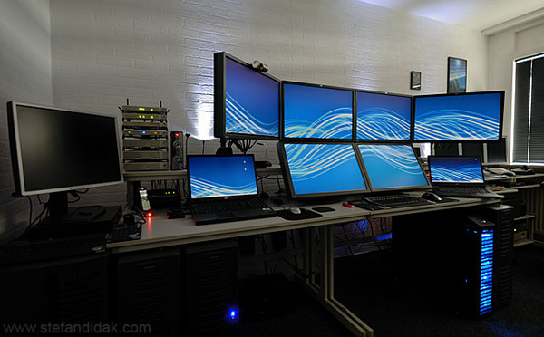
Peripherals
A peripheral is a piece of computer hardware that is added to a host computer.
In this section, we will be studying the various hardware parts that can be added to the PC.

Slide 27
The Optical Drives

Slide 28
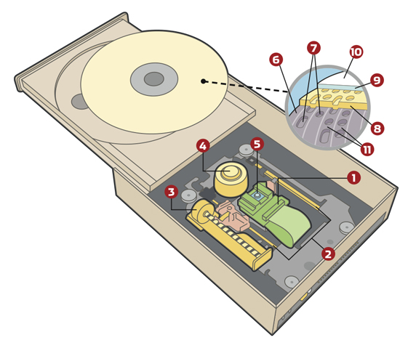
Optical Disc Drives
The Optical Disc Drive is used to read and/or write on the different “Optical Discs”
There are Reader Drives (ROM) and Writer Drives (Burners)
Different Optical Disks require the right Optical Drives to read them or even burn them

Slide 29
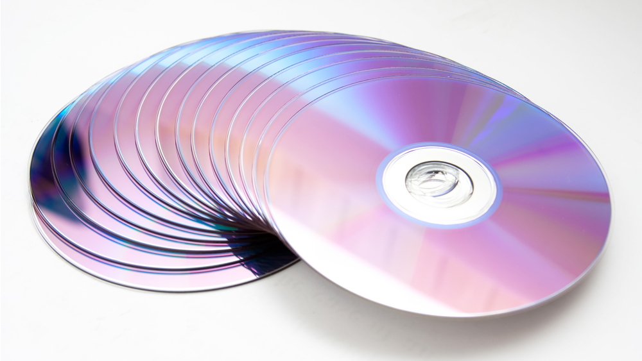
The Compact Disc
Compact Disk is a type of optical disc. It is flat and round, and is used to store digital data.
CD: Compact Disc
Size: 700 MBs
Optical Disc Drives: CD-ROM, CD-R, CD-RW
It is the most resistant Optical Disc against scratches, since it writes at the deepest layer of the disc.

Slide 30
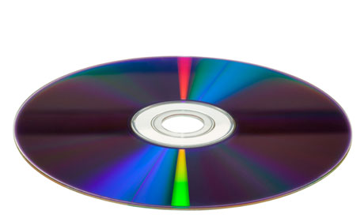
The DVD
DVD: Digital Versatile Disc OR Digital Video Disc
Size: 4.7 GBs
Optical Disc Drives: DVD-ROM, DVD-R, DVD-RW, DVD+R, DVD+RW, DVD±RW
DVDs can be of more size due to Dual Layer technology. It can hold 8.54 GBs per side. Such DVDs require Dual Layer DVD Recorders and not the usual ones.
Notes:
DVD+R and DVD-R are different. They are discs and each have their own drive besides the DVD±RW which can write on both.

Slide 31
Dual Layered Technology
Dual Layer technology provides two individual recordable layers on a single sided DVD disc.
To take advantage of dual layer technology when recording DVDs, you must use a dual layer enabled DVD burner and dual layer DVD media.
Dual Layer is more commonly called Double Layer in the consumer market, and can be seen written as DVD+R

Slide 32
The Blu-Ray Disc
Size: 25 GBs (50 GBs if Dual Layer)
Optical Disc Drives: BD-ROM, BD-R, BD-RE
Blu-Ray Discs are known to be the next step into Home Video where High Definition plays an important role.
Blu-Ray offers more than five times the storage capacity of traditional DVDs and can hold up to 25GB on a single-layer disc and 50GB on a dual-layer disc.

Slide 33


Slide 34
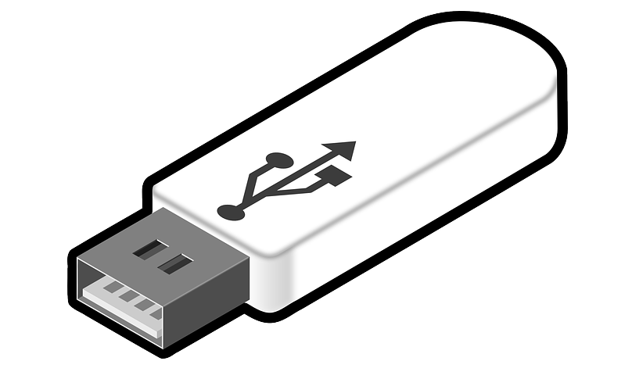
The Universal Serial Bus

Slide 35

The USB
The Universal Serial Bus (otherwise known as USB) is a connection type used to connect peripherals to the computer.
This Technology was first created in January 1996.
The Technology started with version 1.0 then went on to 1.1, 2.0 and USB 3.0

Slide 36
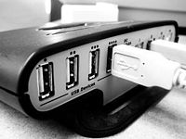
USB 1.0 and 1.1
The 1st USB devices were out in 1996 with USB 1.0 at a speed of 1.5 Mbit/s (Low-Speed) and 12 Mbit/s (Full-Speed)
In 1998, the USB 1.1 was out mainly with fixed problems with usb hubs (shown in the picture below)

Slide 37
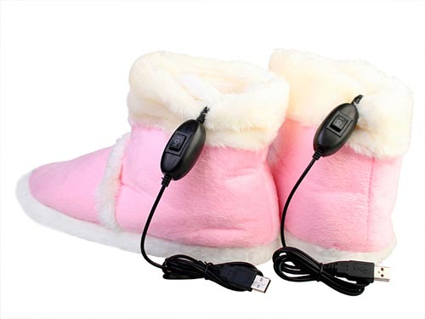
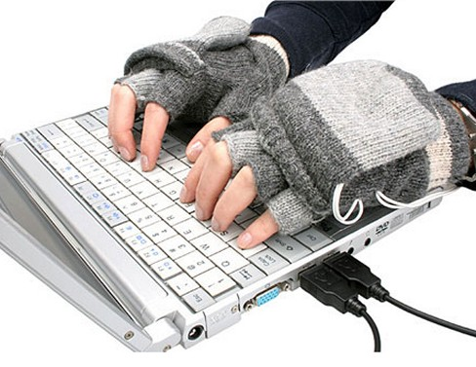
USB 2.0
USB 2.0 was released in 2000 with a transfer speed of 480 Mbit/s (now called Hi-Speed)
The USB 2.0 is used nowadays and is multipurpose.
It is the technology used for Flash Drives, mini-heating devices, battery charging (mainly Phones and the like)

Slide 38
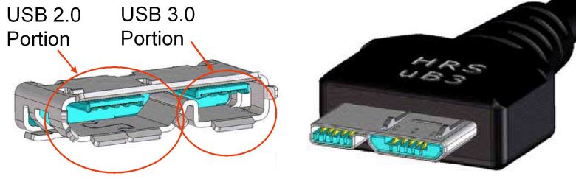

USB 3.0
USB 3.0 is the latest version out in the market.
It has a transfer rate of 5.0 Gbit/sec.
USB 3.0 receptacles are compatible with USB 2.0 device plugs for the respective physical form factors.

Slide 39
Monitors
From CRT to LCD to LED

Slide 40
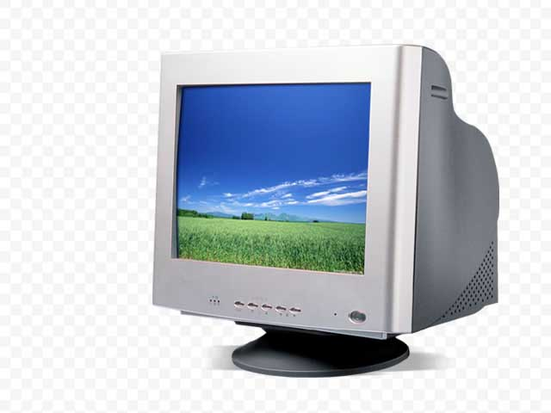
The CRT Monitor
CRT stands for Cathode Ray Tube and is equivalent to the old TV technology originally created in 1897.
It is known to have high refresh rates (higher that 85 Hz) which help in reducing flickering.

Slide 41
CRT
A cathode ray tube (CRT) monitor is an analog computer display or television set with a large, deep casing. This type of monitor uses streams of electrons that activate dots or pixels on the screen to create a full image.
Advantage: - the range of colors they can display
- CRT monitors also have a wider viewing angle and are usually less expensive than similarly sized LCD models.

Slide 42
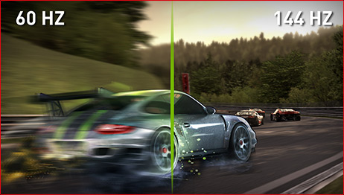
Refresh Rate
The refresh rate is the number of times in a second a display hardware draws the data it is being given.
The higher the refresh rate the more the eye feels relaxed on the long run.

Slide 43
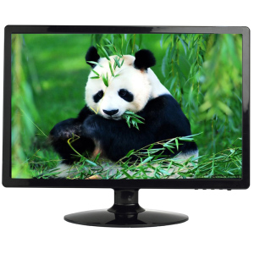
The LCD Monitor
LCD (or Liquid Crystal Display) is another kind of monitor which is mostly used today and has replaced the CRT, whether for PCs or TVs.
It is known to be still not so cheap (at least not as much as CRT) and has lower refresh rates (75 Hz at low resolutions, 60 Hz at high resolutions)

Slide 44
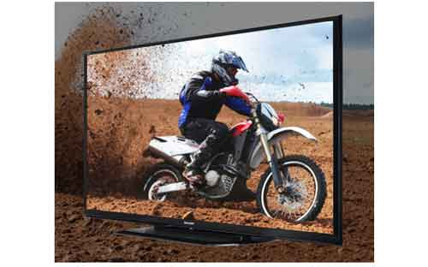
LCD
Advantages:
LCDs are significantly smaller and lighter in weight than CRTs, which makes them better for small offices and similar settings.
They also give less glare and consume much less power than CRT monitors.
LCDs also do not have flicker problems and can run quite well at lower refresh rates.
Refresh
Rate
120 Hz

Slide 45
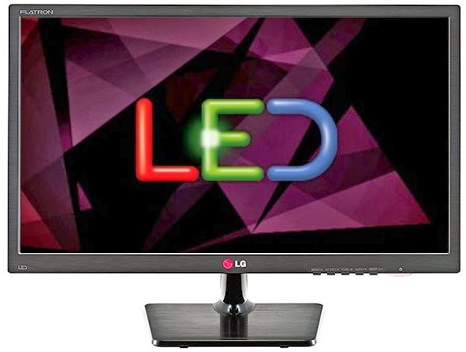
The LED Monitors
LED (Light Emitting Diodes) Flat Panels Consume Less Than Half the Power of Comparable Monitors.
They have a Typical Dynamic Contrast Ratio of Up to 1,000,000:1
LED based monitors are the latest technology and offer HD quality resolution.

Slide 46
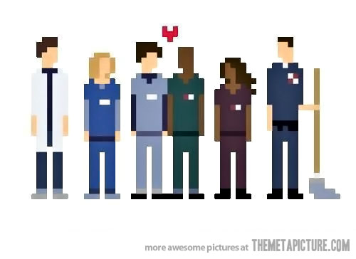
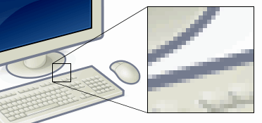
Pixels
The Resolution of every screen is measured by the number of pixels it shows.
It is always written in Width x Height and can be used as measurement for digital photos and videos.
A pixel (or picture element) is the smallest item of information in an image.

Slide 47
The End…

